Slide 1
CLARIN web services and workflow
Marc Kemps-Snijders

Slide 2
Web services
Expected practices and interface descriptions
SOAP → WSDL
XML-RPC → WSDL
REST → WADL, WSDL
Currently web services from a number of organizations:
RACAI
Tokenizing, lemmatizing, chunking, language identification,..
UPF
Statistical services, concordance, querying, …
Leipzig Linguistic Services
Sentence boundary detection, co-occurrence statistics, ..
…
Currently available services are listed in CLARIN inventory

Slide 3
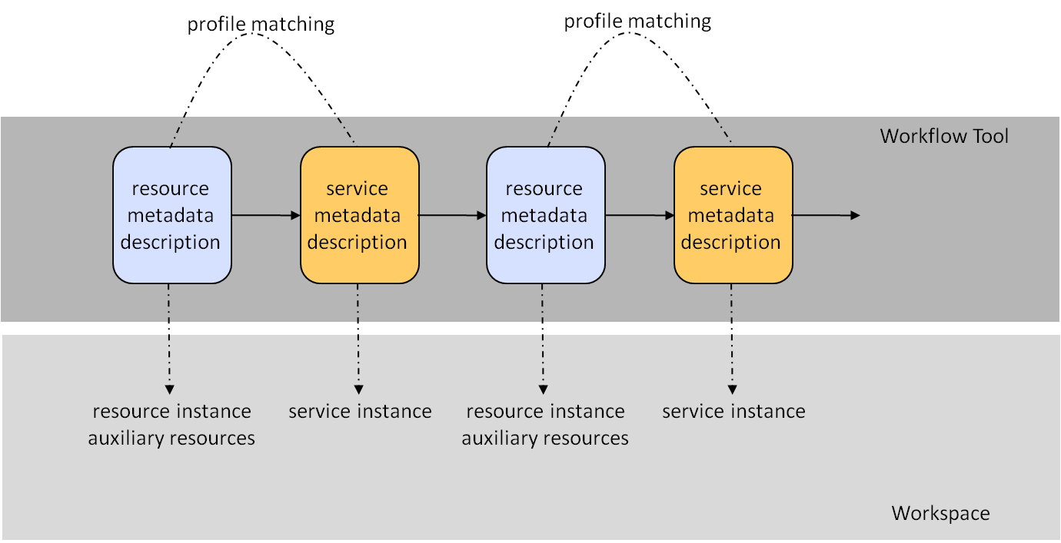
Web service registration
Web service will be registered using CMD Infrastructure.
All services are registered using CLARIN metadata
Metadata serves as the basis for profile matching
This figure indicates the principle of profile matching. A resource can be consumed by a succeeding processing step if the functional characteristics of the resource description map with those that are specified for the input of the tool or web service. The tool or web service will create additional metadata so that for the next processing step the same argument holds.

Slide 4
Workflow
Currently a number of WFMS are in use:
GATE
UIMA
Taverna
JBPM based systems
Clarin claims no preference to any of these.
Human task support
Some tasks require human interaction, e.g. manual annotation

Slide 5
Principles
Web service interactions are governed by 2 guiding CLARIN principles
Each resource is associated with standoff XML metadata (CMD)
Each resource must provide provenance data
The data that results from web service invocations must follow this and provide proper metadata and provenance data

Slide 6
Input parameters
Standard
parameters
Provenance
component
6. Record parameters
Metadata PID
4. Pass configuration parameters
7. Generate
Provenance data
Service
1. Pass PID
Metadata
component
8. Record result data
3. Supply resource data
2. Load metadata
CLARIN metadata description
(CMD)
CLARIN metadata description
(CMD)
5. Create metadata
Resource proxy
Resource Data’
Resource proxy
Resource Data
JournalFile proxy
Provenance data
JournalFile proxy
Provenance data

Slide 7
Architecture (Wrapper)
Wrapper 1
Wrapper 2
Client
Metadata
component
Metadata
component
Service 1
Service 2
Provenance
component
Provenance
component
Client invokes wrapper interface
Wrapper 3
Metadata
component
Service 3
Provenance
component
Each wrapper will contain metadata and provenance component

Slide 8
Architecture (CLARIN Service Bus)
Middleware solution (CLARIN Service Bus) may provide more generic approach
Client
WFMS may be integrated into the CLARIN Service Bus
Calling workflow processes from CSB
Calling CSB services from workflow processes
Web service
…
CSB messaging
Request
…
Metadata component
Provenance component
Service
Result
In memory messaging
CSB Service

Slide 9
Questions
??

Slide 10
Formats, interoperability and standards
Marc Kemps-Snijders

Slide 11
Format interoperability
Interoperability is only relevant if
Resources are to be exchanged
Resources are to be combined in collections
Tools and services need to operate on resources
Results are to be compared
Increasingly the linguistic community not only presents itself from a research perspective,
but also from a service provider perspective
Standardization attempts to solve these cross resource and technology issues by
Looking at existing practices
Provide abstractions
Address sustainability aspects
Seek international consensus
Provide solid grounding through well accepted standards bodies.

Slide 12
Standardization
Basic standards
Unicode – ISO 10646
Widely supported, some glyphs are still missing
Country codes - ISO 3166
Widely supported
Language codes – ISO 639-1/2/3
Many languages not covered, politically sensitive
XML
Widely supported, lack of generic linguistic resource models and semantic grounding
Feature Structures Part 1– ISO 24610-1:2006
Reference XML vocabulary for FS representation
TEI
CLARIN should identify the extent in which competing formats are being used (DocBook, NLM DTD, …)

Slide 13
Standardization
Ongoing standardization projects
Morpho-syntactic Annotation Framework (MAF) – ISO/DIS 24611
Token-word form, does not specify tag sets
Syntactic Annotation Framework (SynAF) – ISO/CD 24615
Draft stage and not usable at this stage
Lexical Markup Framework (LMF) – ISO 24613:2008
Flexible lexicon framework, further concrete testing needed
Data Category Registry (DCR) – ISO 12620:2009 (forthcoming)
Restricted model, no relations, limited constraints specification
TEI/ODD
Combines documentation and schema
Persistent Identification – ISO/CD 24619
Linguistic Annotation Framework (LAF) – ISO/DIS 24612
Annotated resources as graphs, very abstract level

Slide 14
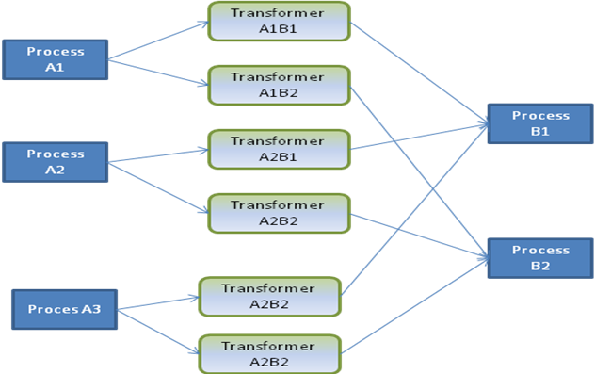
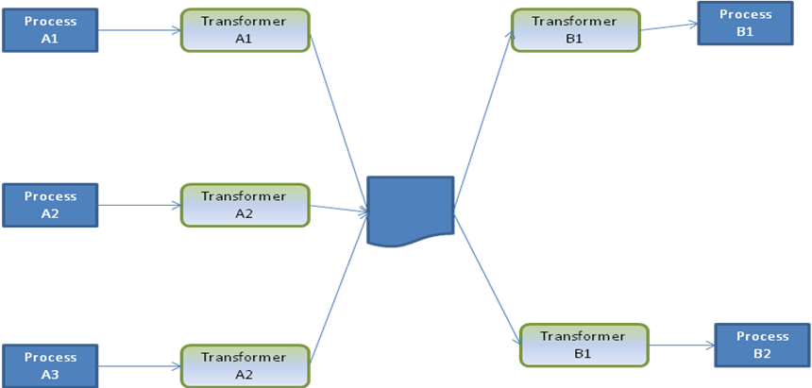
Pivot formats
Pivot
For each combination of processes a transformer is needed
Use of accepted pivot model(s) reduces the amount of transformers needed

Slide 15
Community practices
Formats
CHAT
Shoebox/Toolbox
EAF
EXMERALDA
XCES
PAULA
TIGER
Pentree
….
Tag sets
GOLD
TDS
STTS
EUROTYP
….
….
Clarin will need to make statements on how to deal with these formats (inclusion versus curation)

Slide 16
Thank you for your attention

Slide 17
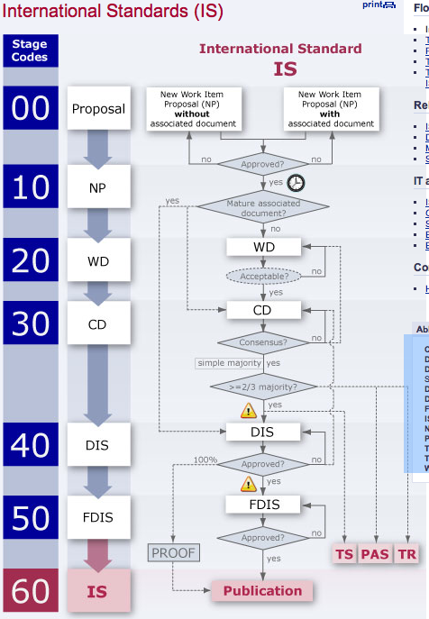
ISO process
CD = Committee Draft
DIS = Draft International Standard
DPAS = Draft Publicly Available Specification
DTR = Draft Technical Report
DTS = Draft Technical Specification
FDIS = Final Draft International Standard
IS = International Standard
NP = New Work Item Proposal
PAS = Publicly Available Specification
TR = Technical Report
TS = Technical Specification
WD = Working Draft

