Slide 1
Formats, interoperability and standards
Marc Kemps-Snijders

Slide 2
Format interoperability
Interoperability is only relevant if
Resources are to be exchanged
Resources are to be combined in collections
Tools and services need to operate on resources
Results are to be compared
Increasingly the linguistic community not only presents itself from a research perspective,
but also from a service provider perspective
Standardization attempts to solve these cross resource and technology issues by
Looking at existing practices
Provide abstractions
Address sustainability aspects
Seek international consensus
Provide solid grounding through well accepted standards bodies.

Slide 3
Standardization
Basic standards
Unicode – ISO 10646
Widely supported, some glyphs are still missing
Country codes - ISO 3166
Widely supported
Language codes – ISO 639-1/2/3
Many languages not covered, politically sensitive
XML
Widely supported, lack of generic linguistic resource models and semantic grounding
Feature Structures Part 1– ISO 24610-1:2006
Reference XML vocabulary for FS representation
TEI
CLARIN should identify the extent in which competing formats are being used (DocBook, NLM DTD, …)

Slide 4
Standardization
Ongoing standardization projects
Morpho-syntactic Annotation Framework (MAF) – ISO/DIS 24611
Token-word form, does not specify tag sets
Syntactic Annotation Framework (SynAF) – ISO/CD 24615
Draft stage and not usable at this stage
Lexical Markup Framework (LMF) – ISO 24613:2008
Flexible lexicon framework, further concrete testing needed
Data Category Registry (DCR) – ISO 12620:2009 (forthcoming)
Restricted model, no relations, limited constraints specification
TEI/ODD
Combines documentation and schema
Persistent Identification – ISO/CD 24619
Linguistic Annotation Framework (LAF) – ISO/DIS 24612
Annotated resources as graphs, very abstract level

Slide 5
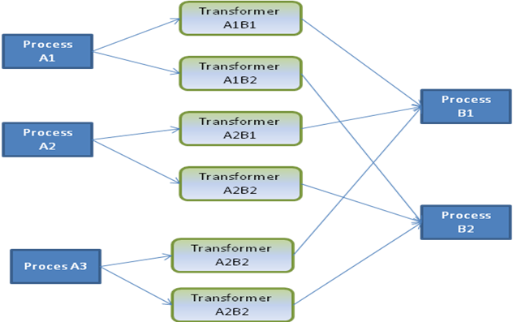
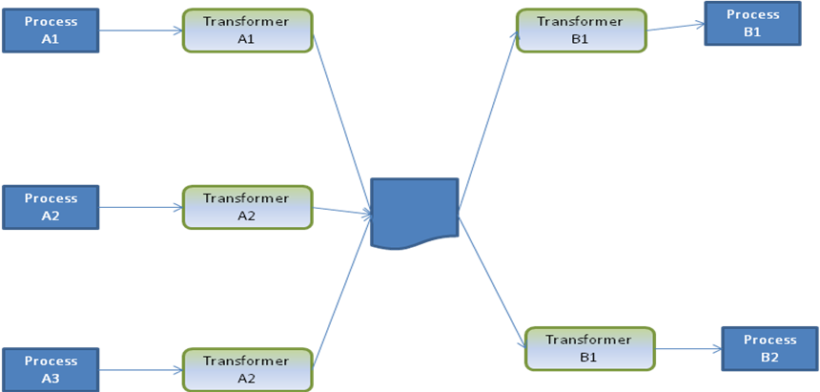
Pivot formats
Pivot
For each combination of processes a transformer is needed
Use of accepted pivot model(s) reduces the amount of transformers needed

Slide 6
Community practices
Formats
CHAT
Shoebox/Toolbox
EAF
EXMERALDA
XCES
PAULA
TIGER
Pentree
….
Tag sets
GOLD
TDS
STTS
EUROTYP
….
….
Clarin will need to make statements on how to deal with these formats (inclusion versus curation)

Slide 7
Thank you for your attention

Slide 8
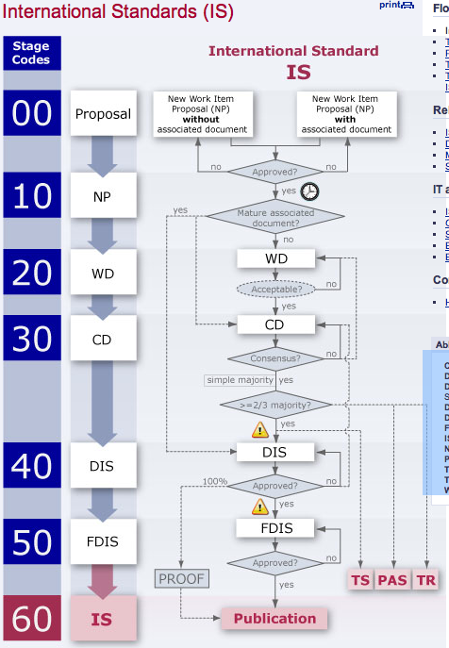
ISO process
CD = Committee Draft
DIS = Draft International Standard
DPAS = Draft Publicly Available Specification
DTR = Draft Technical Report
DTS = Draft Technical Specification
FDIS = Final Draft International Standard
IS = International Standard
NP = New Work Item Proposal
PAS = Publicly Available Specification
TR = Technical Report
TS = Technical Specification
WD = Working Draft

